Slide 1
Mastering the Query Features of Power BI Desktop
Notes:
This module introduces the core concepts of creating and executing queries in Power BI Desktop. Students will learn how to leverage the query features of Power BI Desktop to import data from a variety of sources including databases, Excel spreadsheets, web pages and SharePoint lists. Students will also discover how to design queries to clean up, transform and reshape data during the import process by learning about all the different type of query operations available in the Power BI Desktop query builder. The module also examines the use of query parameters and powerful transform operations such as merging columns and appending rows from multiple data sources. The module concludes by explaining to students how to design queries to convert an OLTP database design into an OLAP data model that is better suited for data analysis and reporting in a Power BI Desktop project.

Slide 2
Agenda
Deciding What To Measure
Understanding Queries in Power BI Desktop
Working with the Query Editor Window
Designing Advanced Combine Queries
Importing OLTP Data Into a Star Schema
Understanding Parameters and Template Files

Slide 3
Data Discovery
Data can live in a variety of sources
Files (e.g. CSV file, Excel workbook)
OLTP Databases
OLAP Databases
SharePoint Lists and Document Libraries
Azure-based services
Online services & SaaS applications
Notes:
Business Intelligence is all about analyzing data and surfacing insights. The first step is always figuring out what data you need and where to find it. The Power BI platform is very extensive in its ability to let you connect to and analyze just about any type of data.
This introduction slide lists the different formats of data you can work with when creating custom solutions for the Power BI platform. We will explore each of these data source types in greater detail a little later in this module. On the next few slides, we will discuss how to determine what you want to measure and why you should create grain statements before you begin designing queries. After that we will explore an OTP-style database named WingtipSalesDB that will be used in instructor demos and in student labs over the next few modules of this training course.

Slide 4
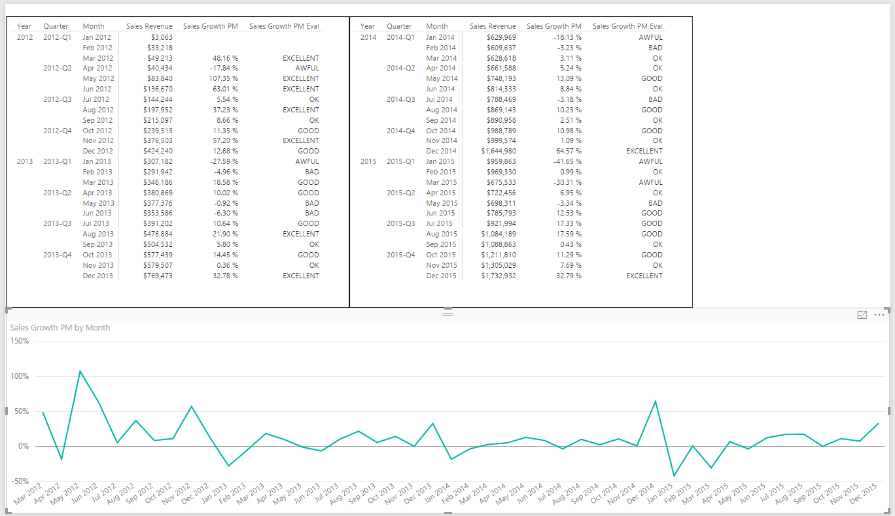
Deciding What To Measure
You Must Determine Measurable Objectives
Financial (revenue, expenses, profit margin, etc.)
Business processes efficiency
Customer Satisfaction Levels
Notes:
When you begin to create any type of custom solution with Power BI to monitor the health and report on business processes, it is important to take a step back in the initial design phase and clearly determine what you’re going to measure. This provides an opportunity to define what type of business analysis and visualizations your custom BI solution will need to provide. For example, one custom solution might just need to track sales revenue in order to calculate commission for sales people. Another custom solution with different requirements might need to analyze expenses and profit in addition to sales revenue. Determining high-level goals and capabilities is an important thing to do before getting into the nuts and bolts of beginning to extract and transform data.

Slide 5
Defining Grain Statements
Grain statements should be defined in initial design phase
Grain statements helps determine requirements for BI queries
Grain statements can be created & understood by business users
Example grain statements for BI project at Wingtip Toys
What was the total sales revenue over the last 4 years?
What was the sales revenue by year, quarter and month?
What was the sales revenue by region, state, city and zip code?
What was the sales revenue by category, subcategory and product?
What was the growth in sales revenue from month to month in 2013?
What was profit margin for each product by year, quarter and month?
Have their been any products with significantly decreasing profit margin?
Notes:
There’s a popular technique for determining what you need to measure and what data you will need to acquire to make those measurements. This technique involves authoring a set of grain statements. What's valuable about grain statements is that they can easily be written by business users with little or no technical experience. However, once you have clearly written a set of grain statements, technical people can use those grain statements to determine what data needs to be imported as well as what queries and reports need to be generated.
The slides above display examples of grain statements that might be used in a custom solution to analyze sales data. If you read through each of these grain statements, you should have a great head start in designing the queries you’ll need to import data into a new Power BI desktop project.

Slide 6
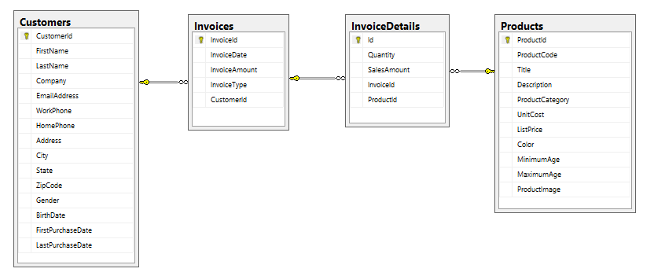
Sample OLTP Database: WingtipSalesDB
Online Transaction Processing (OLTP) System
Used for real-time data access and transaction-based data entry
Optimized for faster transactions (e.g. inserts, updates & deletes)
Tables normalized to reduce/eliminate redundancies
Table schemas can be hard for business users to understand
Notes:
Online Transaction Processing (OLTP) databases are used for databases that have high transaction rates. The data model of tables in this type of database is optimized to speed up transactions for operation such as inserting, updating and deleting records. Tables in an OLTP-style database are usually normalized to reduce or eliminate any redundancies.
Another noteworthy issue is that OLTP systems are often not designed to track historical data. For example, imagine a customer living in California makes a number of purchases over a 5 year period and then the customer moves to Florida. If you run a query to determine sales revenue by state, you will likely find that all the historic purchases for the customer are attributed to the new state Florida and not the state where the purchases were made which is California.
There are several common design issues you face when building BI projects on top of an OLTP database. First, they are not designed with data analysis as a primary objective. Therefore, you must often execute complex queries in a reporting solution which join tables together to properly analyze the data. Moreover, the execution of these complex queries might perform poorly since the indexing scheme configured for an OLTP database is typically optimized for greater transaction throughput instead of faster query performance. Also, the table schema for an OLTP-style database is often complicated and non-intuitive when access directly by the average business user.
Over the next few modules, you will take import the data from the WingtipSalesDB database and reshape it with querying and data modeling techniques to change the design from an OLTP design to an OLAP design that is much better suited for data analysis and reporting.

Slide 7
Agenda
Deciding What To Measure
Understanding Queries in Power BI Desktop
Working with the Query Editor Window
Designing Advanced Combine Queries
Importing OLTP Data Into a Star Schema
Understanding Parameters and Template Files

Slide 8
Power BI Desktop is an ETL Tool
ETL process is essential part of any BI Project
Extract the data from wherever it lives
Transform the shape of the data for better analysis
Load the data into dataset for analysis and reporting
CSV
File
Power BI Desktop
Power BI Desktop Project (PBIX)
Dataset
Excel
Workbook
OLTP
Database
Notes:
Every custom BI solution works with some type of data. Some custom solutions require integrating data from multiple data sources into a single dataset for analysis. Early in the lifecycle of a Power BI desktop project, you must discover where the data you need lives and then you must decide how you are going to import it into a dataset that will eventually be used for data analysis and reporting. This is the project lifecycle phase that is often called the "ETL" phase because it involves extracting data, transforming data and then loading data.
Power BI Desktop is a self-service ETL tool for business users. It has the ability to extract data from a variety of data source. However, the real value of Power BI Desktop is that you can perform many types of transforms to better shape the data just before it's loaded.

Slide 9
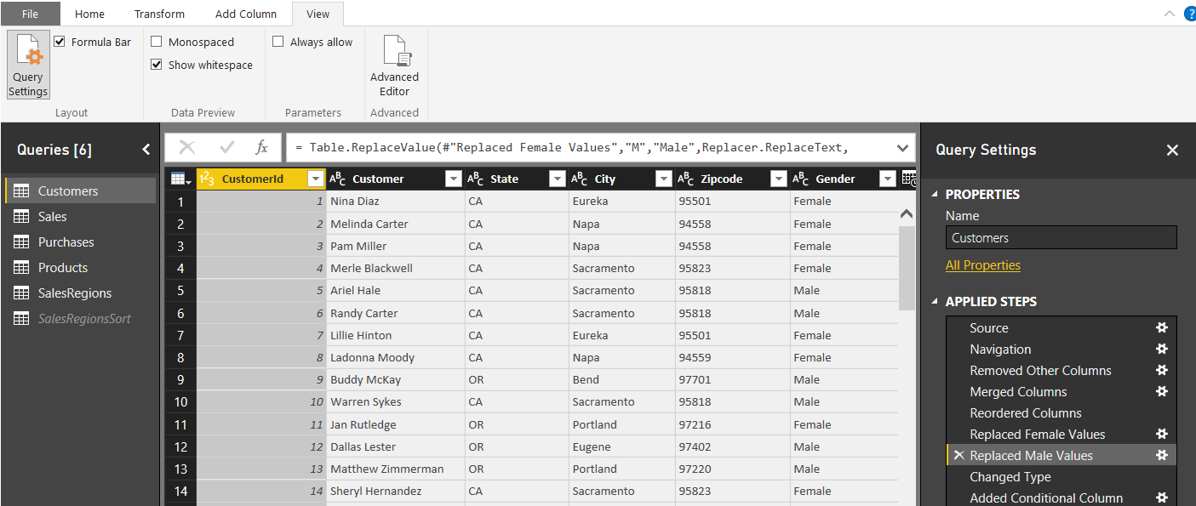
Query Steps
A query is created as a sequence of steps
Each step is a parameterized operation on the data
Each step has formula which can be viewed/edited in formula bar
Query starts with Source step to extract data from a data source
Additional steps added to perform transform operations on data
You can replay query operations one by one by clicking on steps
step formula bar
sequential list of steps for query
Notes:
As you learned in the previous module, every query in Power BI Desktop is defined as a sequence of steps. The Query Editor window displays the Applied Steps section for the query that is currently selected in the Queries list on the left. If you click on a step in the Applied Steps list, you can see how the step is defined behind the scenes using M code in the step formula bar. If the step formula bar is not currently visible in the Query Editor window, navigate to the View tab in the ribbon and check the Formula Bar checkbox in the Layout ribbon group. Once you check the Formula Bar checkbox, you should be able to see the M code that has been generated for the selected step in the Applied Steps list.
Most queries begin with the Source step which is used to extract the underlying data from a specific data source. After the Source step, other steps are added to clean up bad data and to perform transforms as required to reshape the data for analysis and reporting.
Note that you can use the Applied Steps list to debug the logic you have built into a query. You can do this by initially clicking on the first step in the Applied Steps list and then clicking on later steps one by one. When you do this, the Query Editor window will display what the query output looks like after each step. This provides you with the opportunity to see how the entire query will execute in a step by step fashion. If you right-click on a step in the Applied Steps list, you will see a set of menu commands to rename or delete the step as well as to move the step forwards or backwards in the sequence of steps. Some types of steps provide you with the an Edit Settings command which displays a custom dialog box to edit the steps settings. Other types of steps do not provide this capability.

Slide 10
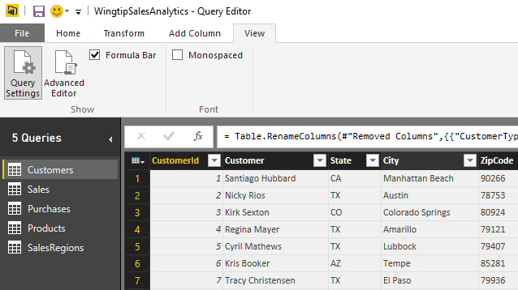
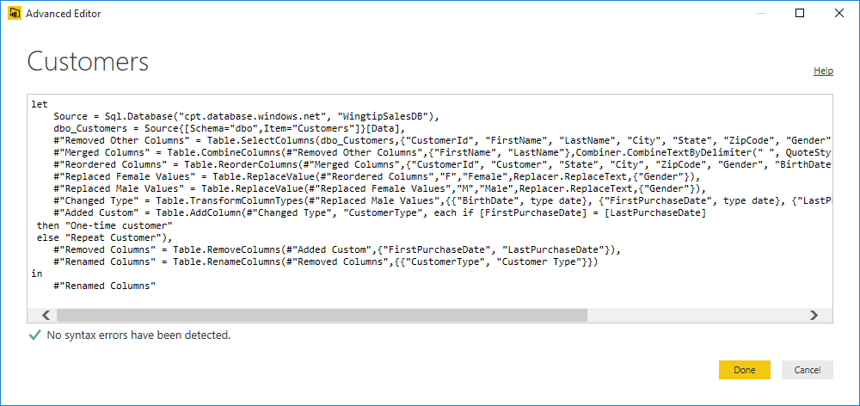
Advanced Editor
Power BI Desktop based on "M" functional language
Query in Power BI Desktop saved as set of M statements in code
Query Editor generates code in M behind the scenes
Advanced users can view & modify query code in Advanced Editor
Notes:
Behind the scenes, Power BI Desktop saves and executes each query you create using a batch of code written in a functional programming language known as M. Microsoft originally created the M programming language and an associated query execution engine for the Power Query add-in that was created for Microsoft Excel 2013 and Microsoft Excel 2010. Now that Microsoft has discontinued its use of “Power Query” as a technology brand name, they continue to use the M programming language to support the authoring and the execution of queries in Microsoft self-service BI products such as Microsoft Excel 2016 and Power BI Desktop. It’s important to note that the Power BI platform can also execute M code to run a query from within the Microsoft cloud when you have configured a dataset for manual refreshing or automated scheduled refreshing.
The user interface experience of Power BI Desktop goes to great lengths to hide M code from you while you are designing and debugging your queries in the Query Editor window. Some people using Power BI Desktop will like that all the M code is hidden out of sight by default. Other more technical users might like the fact that they can view the underling M code for a query and even make direct edits to the M code when it’s the best way to solve a problem.
The step formula bar displays one line of M code at a time. The step formula bar also allows you to make direct changes to the M code for whatever query step is currently selected. However, you can also view and modify the batch of M code for an entire query code using the Advanced Editor dialog. The Advanced Editor dialog can be opened using the Advanced Editor button in the View tab of the ribbon.

Slide 11
Understanding Query Input and Output
PBIX project is container for data sources and queries
Queries created and saved within scope of Power BI project
Queries can pull data from local files
Queries can pull data from external content sources
Queries main purpose is to load imported data into data model
PBIX Project
CSV
File
Data Source
query1
Data Source
query2
External Database
col1 | col2 | col3
bob | 23 | 45
mary | 43 | 74
col1 | col2 | col3
bob | 23 | 45
mary | 43 | 74
col1 | col2 | col3
bob | 23 | 45
mary | 43 | 74
Notes:
When working with Power BI Desktop, you will create and save queries within the scope of the current project. Each query must have at least one data source to use as its input. You can create a query from an external data source such as a CSV file, an Excel workbook, a SQL Server database, an Azure SQL database, a SharePoint list or an Online Service.
Remember that the main purpose of creating queries in Power BI desktop is to import external data to create a base set of tables in your project’s data model. Because of this, a new query is always configured to load its output into a new table generated in the data model for the current project. However, you don’t always want every query to generate an output table in the project’s data model. There are some scenarios in which you will create a query whose sole purpose is to be used as a input for another query. In cases such as these, you can disable a query’s Enable Load property so it does not generate a table in the data model of the current project. While a query with its Enable Load property disabled will not generate an output table, the query can still be used as input to other queries in cases where you want to merge columns or append rows from two different queries to combine content from multiple data sources.

Slide 12
Query Composition
Query can serve as source for other queries
Allows for creation of reusable base queries & query composition
Complexity can be hidden in base queries
Reference command creates new query based on another query
PBIX Project
Data Source
query1
External Database
col1 | col2 | col3
bob | 23 | 45
mary | 43 | 74
query2
query3
table1
table2
col1 | col2 | col3
bob | 23 | 45
mary | 43 | 74
sue | 32 | 47
fran | 41 | 55
col1 | col2 | col3
bob | 23 | 45
mary | 43 | 74
sue | 32 | 47
fran | 41 | 55
Notes:
When working with Power BI Desktop, you create and save queries within the scope of a PBIX project file. Each query must have at least one data source to use as its input. Most queries you create will be based on an external data source. However, you can also create a query which uses the output of another query as it’s data source. This is done by executing the Reference command on a query which creates a new query whose data source is the query on which you ran the Reference command.
By using the Reference command to create a query whose input is based on another query, you can take advantage of a design technique known as query composition. The key concept is that you can create reusable logic in one query and then share that logic across several other queries. That helps to reduce the redundant logic you need to maintain across the queries in the Power BI desktop project.

Slide 13
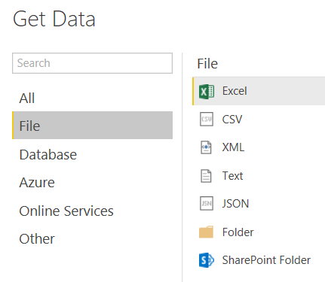
File-based Data Sources
Power BI Desktop supports common file types
Notes:
Power BI Desktop provides rich support for importing data from a wide array of file formats. You can import data from an Excel workbook which contains worksheets with named ranges and tables. You can also import data from a data model that has been created inside an Excel workbook.
It’s become an industry norm to download and make data available using text-based CSV files. If you have already completed the lab for the previous module on Power BI Desktop, then you have already worked through the steps of creating queries to import data from CSV files. You have to admit that the steps are pretty straightforward and easy to accomplish.
Power BI Desktop also supports other types of semi-structured data in common text file formats such as XML and JSON. You can create queries using the data source type of Text which allows you to leverage the data cleanup tools of the Query Editor window. This approach makes it possible to scrape data from non-structured text files when dealing with business documents such as invoices and expense receipts.
You can also use Power BI desktop to import data associated from the set of files in a folder in the local file system or a folder in a SharePoint site. This makes it possible to analyze the files and their metadata inside a specific folder in terms of the number and/or size of files by categories such as file extension, content type or date last modified.

Slide 14
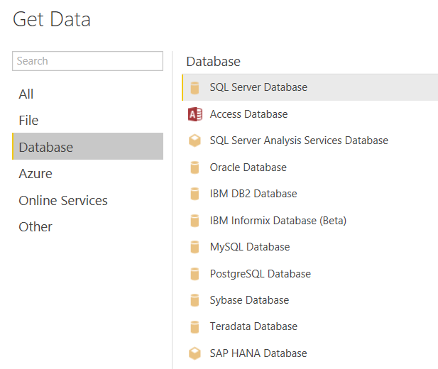
Supported Databases
Power BI Desktop supports many database systems
Notes:
Power BI Desktop supports connecting to all the industry most-popular database systems. What’s especially helpful when importing data from a database is that Power BI Desktop can read database metadata to ensure that table columns are imported with the correct data types and that table relationships defined in the database can be maintained after the data has been imported into the data model for a Power BI Desktop project.
From the list shown in the slide above, you can see that Power BI Desktop has native support to import data from Access databases as well as many popular database management systems for running OLTP-style databases including SQL Server databases, Oracle databases, DB2 databases, MySQL databases, PostgreSQL databases, Sybase databases and Teradata databases.
In addition to supporting OLTP-style databases, Power BI desktop also supports connecting to OLAP-style databases in SQL Server Analysis Services (SSAS). This includes both Tabular databases as well as class multidimensional databases which are based on multidimensional cubes and key performances indicators (KPIs).

Slide 15
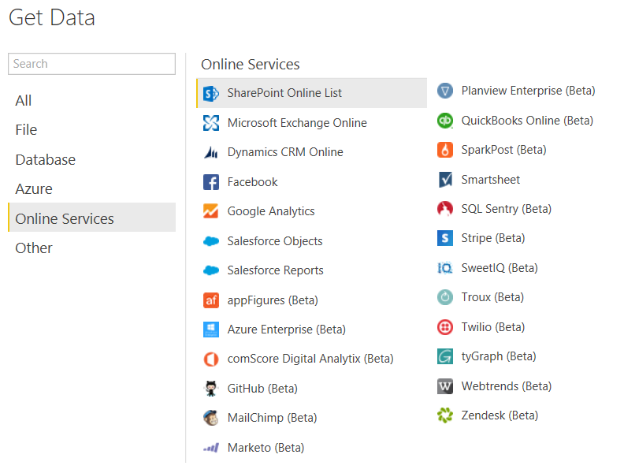
Online Service Data Sources
Power BI Desktop Supports Online Services
Includes popular Software-as-a-Service (SaaS) applications
Microsoft is working with 3rd vendors to expand this list
Notes:
Over the last decade, the software industry has witnessed the rise in popularity of Online Services based on the Software-as-a-Service (SaaS) application model. The success of commercial online services such as Salesforce, Dynamics CRM Online, QuickBooks, GitHub and Google Analytics has created pockets of essential business-related data in vendor-specific clouds. The ability to freely import, analyze and report on this cloud-based data provides businesses and organizations with a new opportunities to monitor and evaluate their business processes.
Consider a simple example. Image you work for a large company that uses Google Analytics to track website usage on its public website. If you don’t like the way that the Google Analytics web portal reports on the data they have recorded about your company’s website, you have another option. You can use Power BI Desktop to analyze the exact same data and present your visualizations and insights in a different way. You can start by importing the Google Analytics data from the cloud into a set of base tables and then layering on your own calculated columns and measures to enrich the data model. After that, you leverage the Power BI platform and it’s ability to create interactive reports and mobile-friendly dashboards. Once you have deployed this type of custom solution, you can then configure the Power BI service to synchronize the imported dataset with its cloud-based data source in the Google Analytics service several times over the course of a standard business day.
The list of Online Services shown in the slide above is a testament to Microsoft’s ongoing investment to integrate Power BI Desktop and the Power BI platform with a growing number of Online Services. You can import data from Microsoft services including SharePoint Online, Exchange Online and Active Directory. Microsoft has continued to invest in relationships with 3rd vendors which is helping to expand the list of services which you can use as a data source when building a custom solution for the Power BI platform.

Slide 16
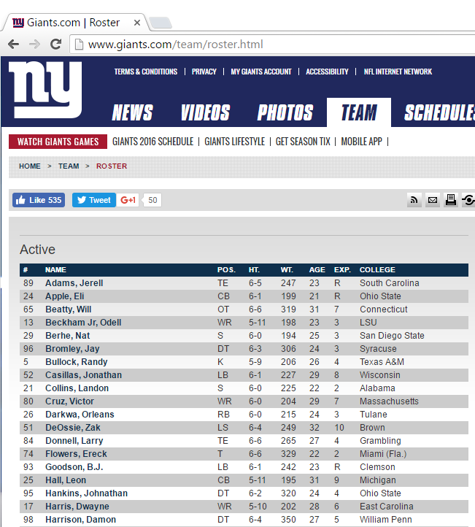
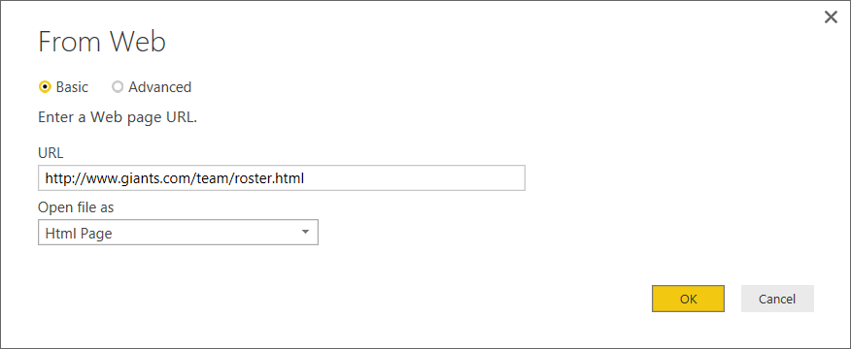
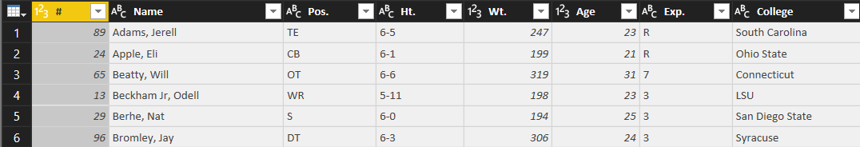
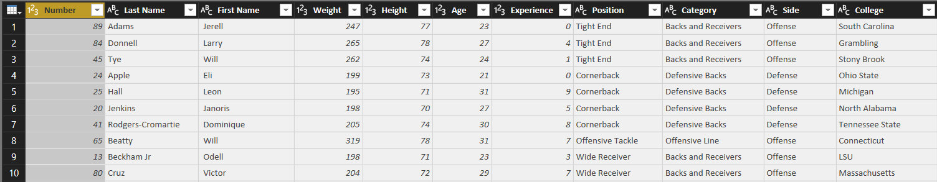
Working with Web Data Sources
Many public websites publish data using HTML tables
Power BI desktop can scrape data from tables in HTML pages
Query Input
Query Output
Notes:
There is a wealth of data that has been published by public websites on the Internet using HTML tables. Power BI Desktop makes it straightforward and relatively painless to extract data from tables in HTML pages and to clean up this data to condition it for insightful data analysis.
The National Football League (NFL) in the United States has 32 teams each of which hosts a public website with its roster of active players in an HTML table. For example, the HTML page with a table with the roster of active players on the New York Giants is accessible through the URL of http://www.giants.com/team/roster.html. Between this URL and the 31 URLs for the other teams, Power BI Desktop can extract and analyze data about every active player in the NFL.
Working with NFL active player data extracted from public websites provides a great way to learn about cleaning up data. The slide above shows the raw query input. When importing data into Power BI desktop, your query output can be designed to rename columns, to convert column values into numeric data types and to add extra categorization aspects to the data using lookup tables and merge queries.

Slide 17
Scraping Data from a Web Page

Slide 18
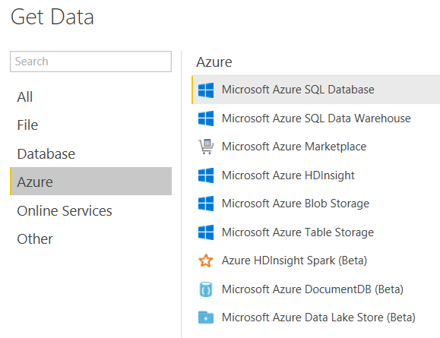
Azure Data Sources
Power BI Desktop supports many Azure data sources
Notes:
It’s clear that Microsoft is investing heavily in Microsoft Azure and Azure-based services to give its customers a cloud-based platform for building software solutions. Microsoft Azure provides several different ways to store data in the cloud including semi-structured data stored using tables, queues and blobs. Microsoft Azure also offers a cloud-based version of a SQL Server database. In fact, you will connect to an Azure SQL Server database as a data source in your next lab. That means you will get hands-on experience extracting data from the Microsoft Azure cloud in order to import customer and sales data for analysis and reporting.
Microsoft Azure HDInsight provides the means to capture large amounts of streaming data in a design process that the industry has gotten to know as “big data”. If your company is already using HDInsight, you can use Power BI Desktop to connect directly to its data or you can use an big data adapter such as Azure HDInsight Spark which provides an abstracted query layer on top of the data structures stored in an HDInsight dataset.
Microsoft Azure also provides the ability to design and populate a SQL Data Warehouse in the cloud. For companies that are taking this direction to build a cloud-based data warehouse, Power BI Desktop will be at the top of the list in in terms of effective data analytics and reporting tools to build on top of a SQL Data Warehouse.

Slide 19
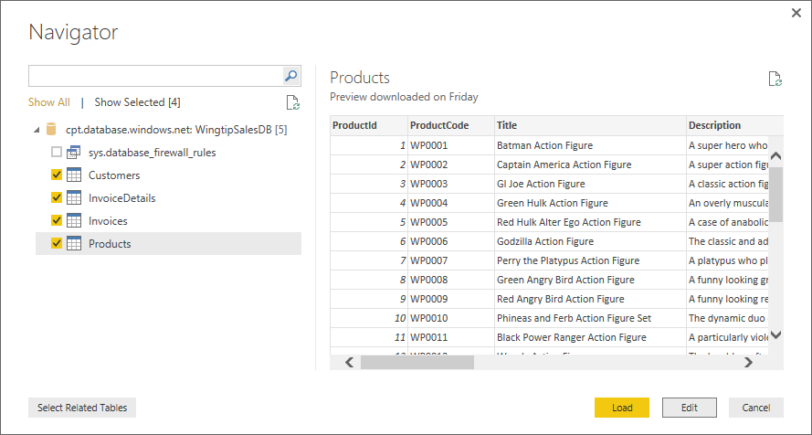
Selecting Tables from a SQL Database
Power BI Desktop provides Navigator dialog
Allows you to select tables
Navigator understands existing table relationships
Clicking Load will run query and import data
Clicking Edit will open queries in Query Editor window
Notes:
When connecting to a SQL Server database or a Azure SQL Server database, you will be prompted with the Navigator dialog which allows you to select which base tables you would like to import into your project. In your upcoming lab, you will extract data from an Azure SQL database named WingtipSalesDB. When you go through this lab, you will use the Navigator dialog to select the four tables from the database which includes Customers, Invoices, InvoiceDetails and Products. When you click the Edit button to dismiss the Navigator dialog, you will see that Power BI Desktop has actually created 4 new queries. There will be an separate query created for each table you selected in the Navigator dialog.
When Power BI Desktop inspects the schema of the tables in a SQL database, it has the ability to read metadata to determine which tables are connected through relationships. Power BI desktop can then use this knowledge to properly recreate the table relationships when importing sets of related tables into the data model for a specific project. The best part is that all this happens automatically behind the scenes and doesn’t require your attention.

Slide 20
Creating Queries to Import Data from an Azure SQL Database

Slide 21
Agenda
Deciding What To Measure
Understanding Queries in Power BI Desktop
Working with the Query Editor Window
Designing Advanced Combine Queries
Importing OLTP Data Into a Star Schema
Understanding Parameters and Template Files

Slide 22
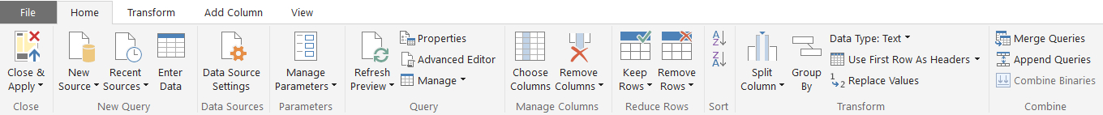
Query Editor Ribbon Tabs
Home tab
Transform tab
Add Column tab
View tab
Notes:
The screenshots in this slide shows the four different tabs available in the ribbon of the Query Editor window which include the Home tab, the Transform tab the Add Column tab and the View tab. Note that the button and other controls in these ribbon tabs are context-sensitive. That means which column or columns are currently selected will determine which ribbon commands are currently available. For example, some commands in the ribbon will be disabled when you do not have anything selected on which to run those commands.

Slide 23
Examples of Basic Power BI Desktop Steps
Rename column
Convert column type
Format column values
Reorder columns
Replace column values
Expanding related column
Merging columns
Splitting columns
Notes:
This slide above lists some of the more command operations that can be added as applied steps to a query when working within the Query Editor window. For example, you might want to rename a column so the column name in the query output is different than the name of the underlying column in the database from where you are importing it. You also might want to convert a column data type, format column values or reorder columns as they appear in the query output.
Some of the common operation listed in the slide above can be more complicated. For example, expanding related column allows your query to perform a logical join between two or more underlying tables. Merging columns allows you to combine the values from two columns into a single column and splitting columns make it possible to separate values from a single column into two or more columns.

Slide 24
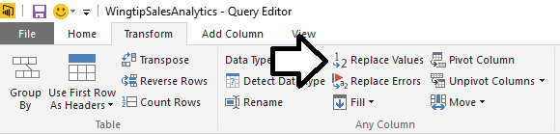
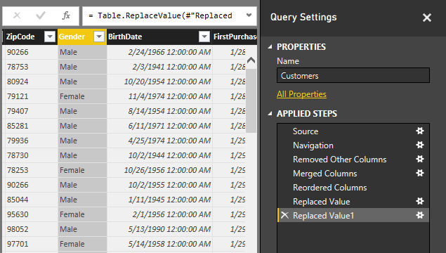
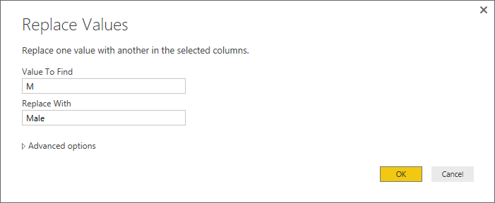
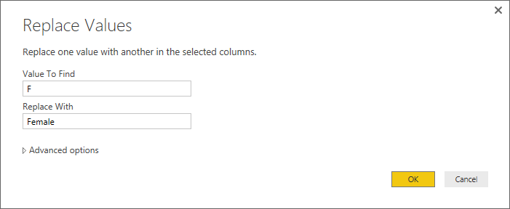
Replacing Values
Used to substitute values during import
Notes:
The operation for replacing values is often used to clean up data. Let’s look at an example. Imagine you have a database with a Customers table contains a Gender column and each row contains a value or either “M” or “F”. When you create reports on the Customers table, you want to show what percentage of customers are men as compared to women.
While you can display the underlying Gender values of “M” and “F” directly in a report, it might be more readable to your users to replace all “M” values with “Male” and all “F” values with “Female”.
The Replace Values operation makes this very easy to do as part of the transform that is run in the Customers table as the data is imported. Note that you will need two separate operations as one will find all “M” values and replace them with “Male” and the second will operation one will find all “F” values and replace them with “Female”.

Slide 25
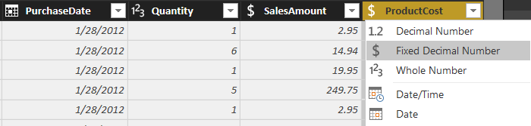
Converting Column Types
Transform data to make it more reliable
Convert date-time column to date column
Transform data to make it more efficient
Convert decimal to fixed decimal number for currency
Beware: Conversion can have destructive effect on data
Notes:
When creating queries in Power BI Desktop, it is a very common undertaking to convert column types as the data is imported into a Power BI Desktop project. For example, if you are creating a query to import database columns that contain currency values, you should explicitly convert these column values to a type of Fixed Decimal Number. When importing date values, it is also very common to convert from the Data/Time data type to a Date data type so that the imported date values have only a date component without a time offset.
Note that the Query Output window display the type of each column in the upper left-hand corner of the column header. This makes it easy to examine a query in the Query Editor window and quickly determine what data type Power BI desktop will use for each column in the query output. If you see that a column in the Query Editor window is not being imported using the most appropriate data type, you can click on the header for that column to drop down the column type menu as shown in the slide above where the ProductCost column is being configured to explicitly convert its values into the Fixed Decimal Number type.

Slide 26
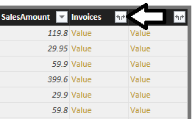
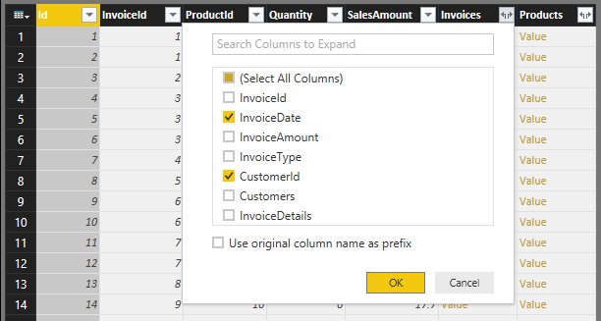
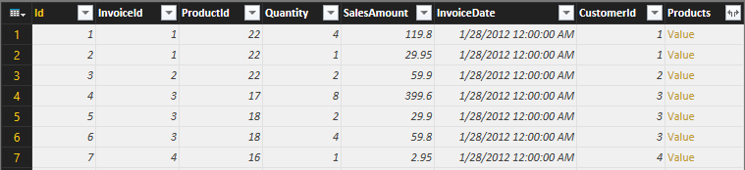
Expanding Related Columns
Used to pull data from related tables
Saves you from performing SQL joins or VLOOKUP
Notes:
When you are importing data from a database that has multiple tables, it is common to create a query whose output contains data from two or more tables. Consider the example with the database named WingtipSalesDB which has an InvoiceDetails table and an Invoices table.

Slide 27
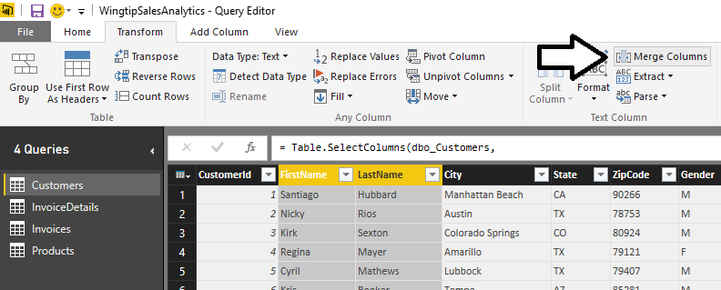
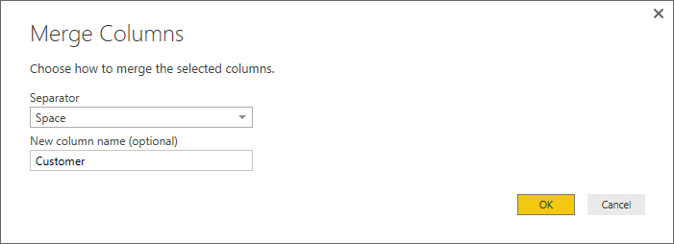
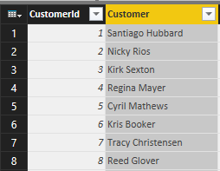
Merging Columns
Merge two columns into a single column

Slide 28
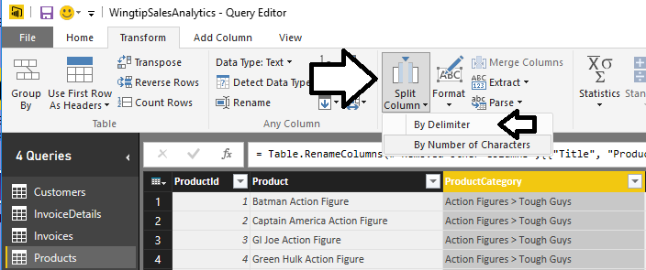
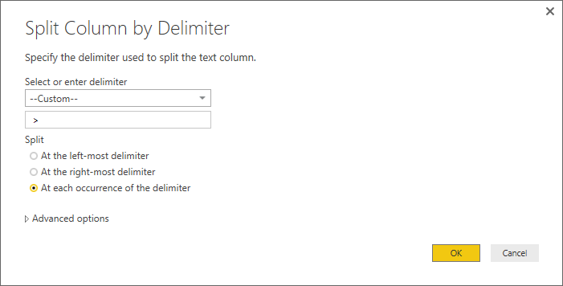
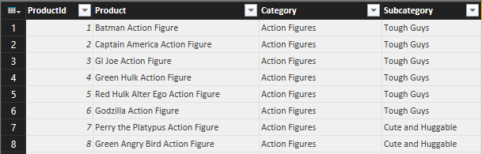
Splitting Columns
Split a single column up into two columns

Slide 29
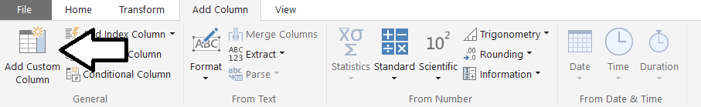
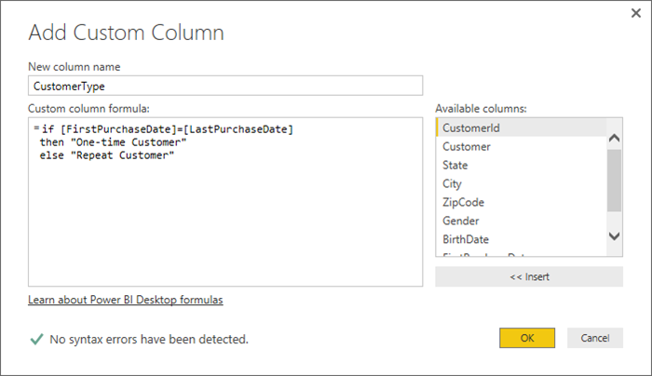
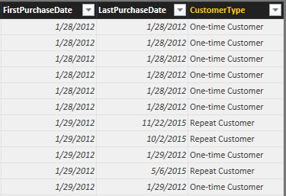
Adding a Custom Column
Custom column provide custom logic
Logic must be written in M programming language

Slide 30
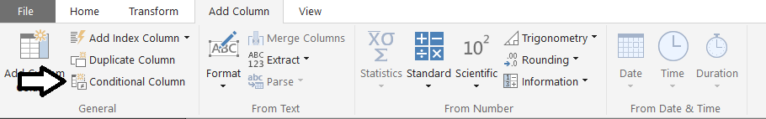
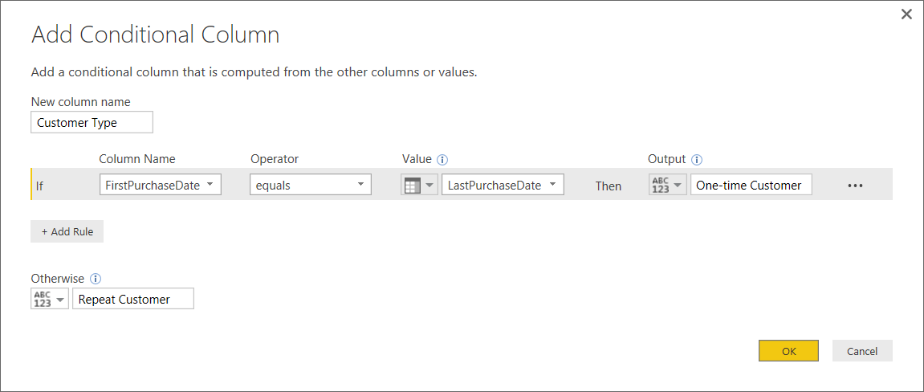
Adding a Conditional Column
Abstracts away need to write M code

Slide 31
Using Queries to Transform Data During the Load Process

Slide 32
Agenda
Deciding What To Measure
Understanding Queries in Power BI Desktop
Working with the Query Editor Window
Designing Advanced Combine Queries
Importing OLTP Data Into a Star Schema
Understanding Parameters and Template Files

Slide 33
Combining Queries
Query can be merged or appended with another query
Merge operation allows you combine columns from two tables
Append operation allows you to combine rows from two tables
Two queries are combined into single output for loading
Load settings of main query determines where output is loaded
Secondary query acts as source for main query
Secondary query be can created with connection-only load setting
Data Source
Data Source
Data Source
query2
Data Source
main query
query2
main query
query3
Data Source
query output
query4
Data Source
col1 | col2 | col3
bob | 23 | 45
Oft | 43 | 74
sue | 32 | 47
fran | 41 | 55
query output
Notes:
Power BI Desktop allows you to combine to queries. Combining queries means that you are combining two data sources into a single table as the queries output. Power BI Desktop supports two combine operations which are merge and append. A merge operation is used when you need to combine columns in from two tables into a single table. An append operation is used when you need to combine rows from two tables into a single table.
Consider that combining two queries produces a single output. Yet each of the queries involved has its own Power BI Desktop load setting. You configure the load setting of the main query to determine where to load the result of the merge/append operation. However, the secondary query which is only being used as the source in another query doesn't usually need to load its output anywhere in the workbook. When you are creating a query whose sole purpose is to be used as a source for a merge or append operation in another query, you can disable loading by configuring the load setting as a "connection-only" query.
What if you need to append together rows from more than one table? That's not a problem. A main query can include more than one append operation as shown in the diagram above on the right. This means a single query can append together rows from as many source tables as necessary.

Slide 34
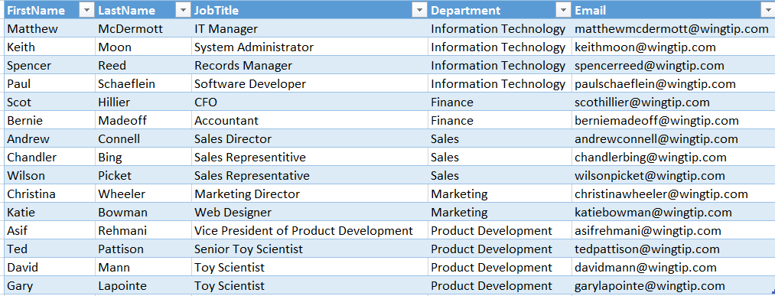
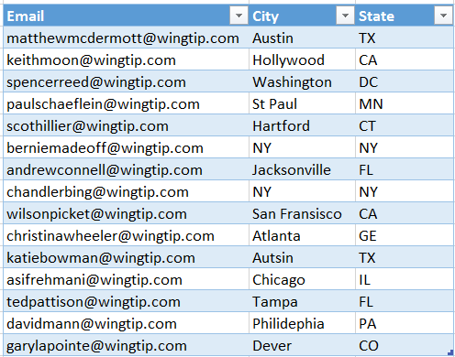
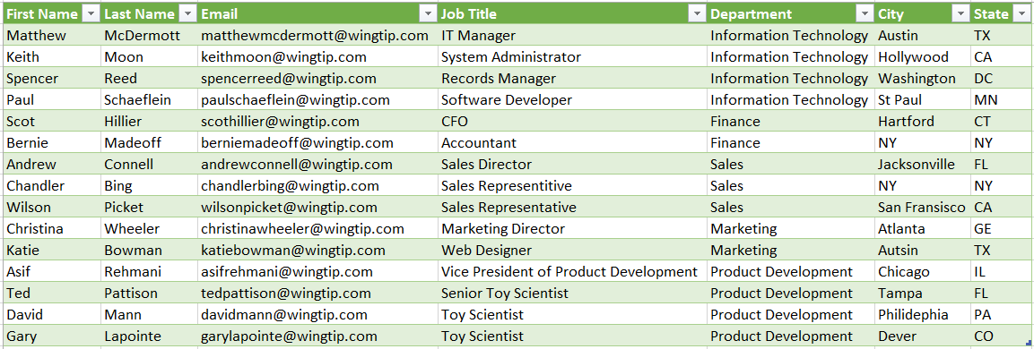
Merging Columns
Main Query Input
Merge Query Input
Join Column
Join Column
Query Output
Notes:
Merging columns is a transform operation that you can perform on two tables that have either a one-to-one relationship or a one-to-many relationship. When you merge columns from two tables together, must a select a key column in each of the tables to perform the equivalent of a database join operation.

Slide 35
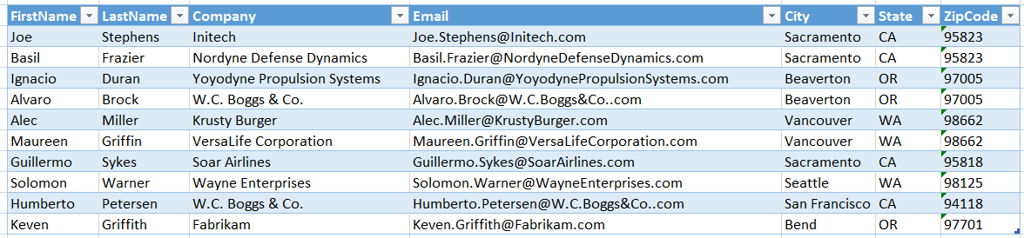
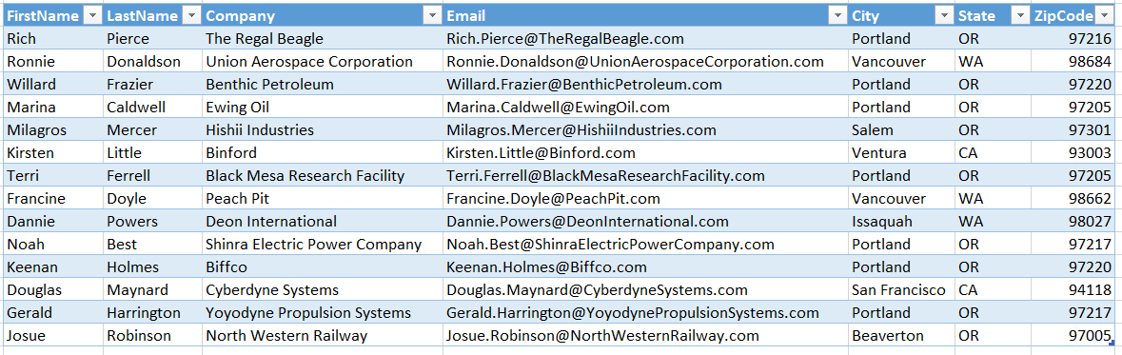
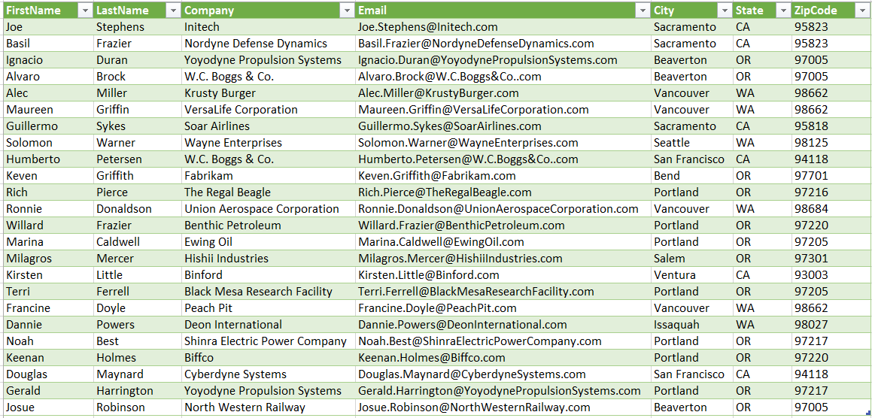
Appending Rows
Main Query Input
Append Query Input
Query Output
Notes:
Appending rows is a transform operation that combines the rows of two or more tables into a single output table. In general, you should ensure that all of the tables used in a append operation all have an identical set of columns with respect to column name and column datatype.
Consider an example. Imagine you append the rows from two tables. If the first table contains a column named Email that is not included in the second table, the Email column is included in the query output and all the rows added from the second table will have a blank value for the Email column.

Slide 36
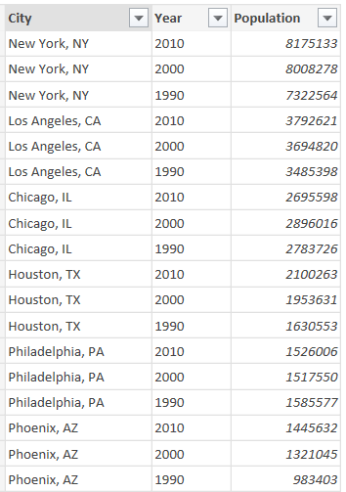
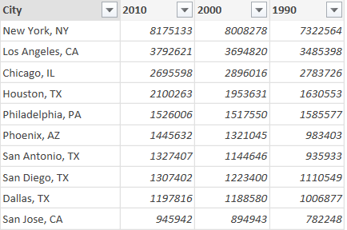
Pivoting Columns
Pivot column adds its values are new columns
Create table layout like PivotTable

Slide 37
Unpivoting Columns
Unpivot columns to collapse them into single column
Removes PivotTable layout
Can be useful to prepare data for charting and analysis

Slide 38
Agenda
Deciding What To Measure
Understanding Queries in Power BI Desktop
Working with the Query Editor Window
Designing Advanced Combine Queries
Importing OLTP Data Into a Star Schema
Understanding Parameters and Template Files

Slide 39
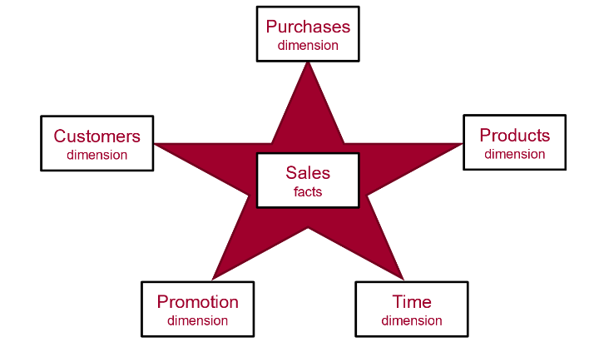
Data Modeling using a Star Schema
OLAP Modeling often based on Star Schema
Tables defined as fact tables or dimension tables
Fact tables related to dimension table using 1-to-many relationships

Slide 40
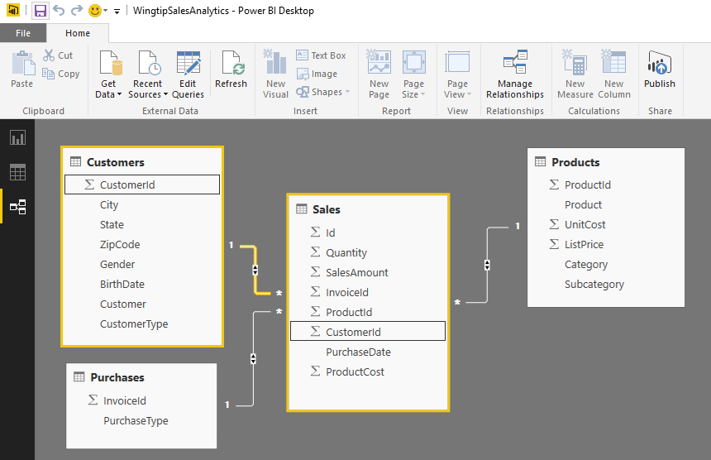
Designing Queries to Build a Star Schema
Converts OLTP Data Model to OLAP Data Model
Sales table is modeled as a OLAP Fact Table
Other tables are modeled as OLAP Dimension tables
Requires pulling CustomerId column into Sales table
All dimension tables should be directly related to fact table

Slide 41
Using Power BI Desktop to Import Data into a Star Schema

Slide 42
Agenda
Deciding What To Measure
Understanding Queries in Power BI Desktop
Working with the Query Editor Window
Designing Advanced Combine Queries
Importing OLTP Data Into a Star Schema
Understanding Parameters and Template Files

Slide 43
Query Parameters
What is a Query Parameter?
Configurable setting with project scope
Strongly-typed value to which you can apply restrictions
Can be referenced from a query
Can be referenced from DAX code in data model
Where are Parameters commonly used
To parameterize data source connection details
To filter rows when importing data
Notes:
In the summer of 2016, the Power BI team added new support to Power BI Desktop so that you can create configurable parameters within the scope of a Power BI Desktop project. The two primary scenarios for creating project parameters is to parameterize data source settings and to parameterize filter criteria used in queries.

Slide 44
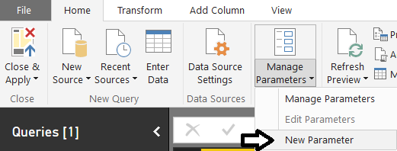
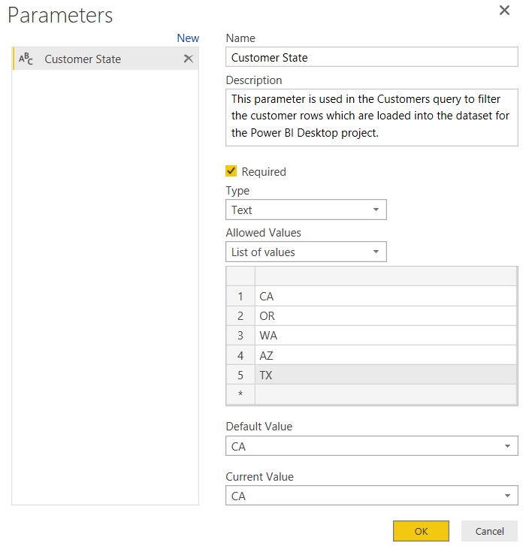
Creating Query Parameters
Parameters can be created using Manager Parameters menu
Parameter properties
Name
Description
Required
Allowed Values
Default Value
Current Value
Notes:
When you create a new parameter, you must give it a name and then you must configure its other properties. The Name property of a parameter is what you use when you need to reference the parameter. Each parameter has a Description property as well as a Required property and a Type which can be used to restrict the values which can be assigned to the parameter.
The Allowed Values property for a parameter provides even more control in configuring the allowed set of values for a given parameter. For instance, you can restrict the allowed values using a static list of values. The example show in the screenshot in the slides shows configuring a parameter to only accept values from a static list of states. . Users will then be able to pick one of these states when specifying the parameter value to use.
The Default Value property allows you to specify what the default value or selection should be used by default. The Current Value property allows you to specify the value that should be used for the parameter in the current report.

Slide 45
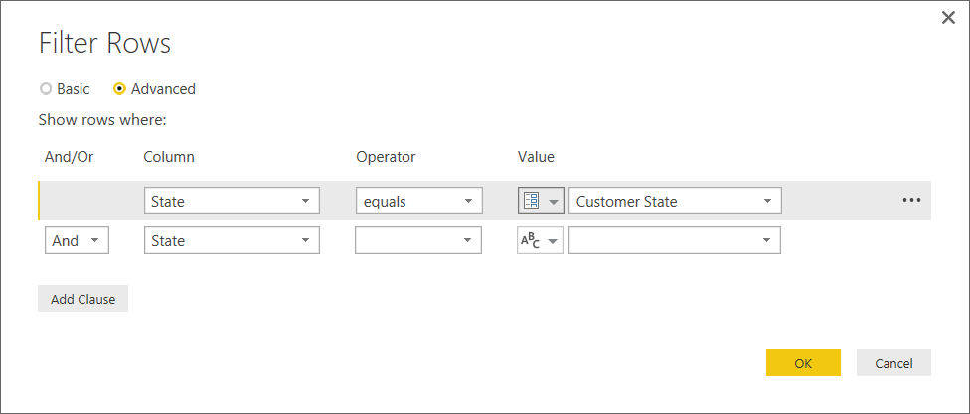
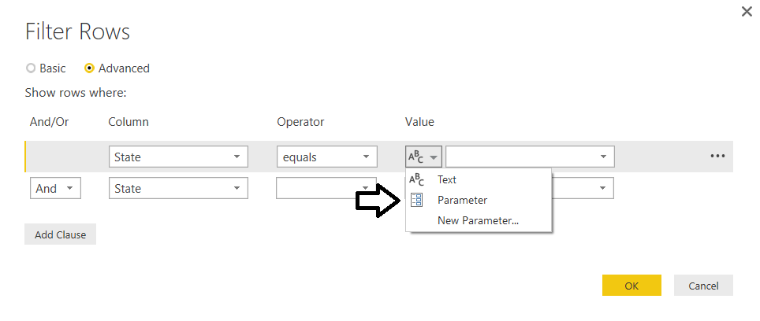
Referencing Parameters in a Query
Parameters can be referenced inside query
Next query execution uses current parameter value
Notes:
To use a parameter, you can reference it from one of the Power BI Desktop dialog boxes that allow you to configure data source settings or filter criteria in a query. However, you will find that many of the dialog boxes used by Power BI Desktop do not yet support configuring values using parameters. Over the next few months, the team that is updating Power BI desktop will continue to add support for using parameters to more of the application’s dialog boxes.

Slide 46
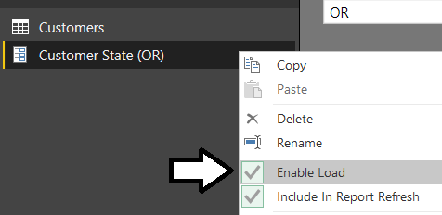
Making Parameters Available to Data Model
Configure parameter's Enable Load setting
Parameter becomes visible within fields list in report view
Notes:
Note that parameters, by default, are not visible within the project’s data model and cannot be used in visuals you add to reports or to the DAX expressions you write. However, you can configure the Enable Load property for a parameter to make it show up in the project’s data model. Once you have done this, the parameters will be visible to the project’s data model which can be handy when you are trying to parameterize values and lists of values that are displayed on a report.
In the example shown in the slide above, the Customer State parameter has been configured with the Enable Load property. Once a parameter has been configured with the Enable Load property, it appears in the project’s data model as a table with a field. This makes for a flexible design technique because it makes it possible to add a visual to a report that displays the parameter’s Current Value property. You can then update what is displayed on the report by simply updating the parameter’s Current Value property.

Slide 47
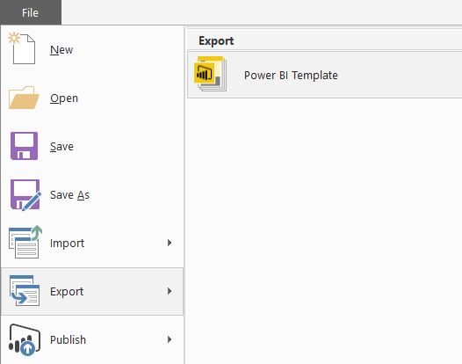



Power BI Project Template Files
PBIX project can be exported to project template file
Template file created with PBIT file extension
Generated template files contains everything except for the data
PBIT template file can be imported to create new PBIX projects
Template files are powerful when used together with parameters
How are template files used?
Export PBIX project to create a PBIT template file
Import the PBIT template file to create a new PBIX project
export
import
Notes:
About the time Microsoft added support to Power BI Desktop for creating parameters, they also added support for exporting the assets from a Power BI Desktop project to a specialized format for a project template file. A Power BI Desktop template file is like a PBIX file in that it is created as a ZIP archive using the Open Packaging Convention. You create a project template file by running the Export > Power BI Template command from the File menu. When you run the Export command, Power Bi Desktop creates the project template file by exporting assets from the PBIX file including the query definitions, the data source settings, the data modeling definitions for calculated columns and measures as well as the project’s report definition.
A Power BI Desktop project template file has a few important differences when compared to a PBIX file. First, a project template file has a file extension of PBIT instead of PBIX. Second, the project template file contains never contains any rows of data. The key idea is that exporting a project to a project template file copies everything you need except for the data itself. Therefore, PBIT files are often very small in size when compared to PBIX files. When you run the Import > Power BI Template command to import the project template file and create a new Power BI Desktop project from a PBIT template file, that is when Power BI Desktop will import the data.
Template files can be especially powerful when used together with project parameters. For example, imagine you have created a complete BI solution with a Power BI Desktop project that connects to a SQL Server database in a development environment. You can choose to create a parameter to configure the data source settings so that your project does not include hardcoded data source settings to your development database. Next, you can export the PBIX project to create a PBIT project template file containing all the definitions you have created for queries, calculated columns, measures and reports. This parameterized approach makes it easier when you deploy your custom solution to multiple customer environments which will each be running their own separate instance of the SQL Server database. When you import a PBIT file that contains the data source parameter, you will be prompted to enter the data source details for that particular customer environment. After you have configured the data source settings parameter for the new project, Power BI Desktop will execute all your queries to fill the project’s data model with rows of data from the correct database for that customer environment.

Slide 48
Summary
Deciding What To Measure
Understanding Queries in Power BI Desktop
Working with the Query Editor Window
Designing Advanced Combine Queries
Importing OLTP Data Into a Star Schema
Understanding Parameters and Template Files

